Slide 1
Instructor Course 2021 Edition
PTC
Primary Trauma Care
Foundation
1

Slide 2
Objectives of the Day
At the end of today you will be able to
understand the PTC Course content & how we teach it
understand the theories behind effective teaching & learning
identify the skills we need to teach & learn effectively
apply these skills & knowledge to delivering the PTC Course
2

Slide 3
Contents of the Day
How adults learn
Interaction, teaching and learning
Communication skills
Different ways of asking questions
How to give feedback
How to use 4 different teaching methods
Planning for the next course
3

Slide 4
PTC principles
Adaptable to local practice
Appropriate teaching materials
Use varied teaching methods
Positive interaction & good relationships
Encourage & learn from local participation
4

Slide 5
Interaction, Communication and Learning
5

Slide 6
How adults learn
Aim
To understand how adults learn
6

Slide 7
How adults learn
Definition
Learning
Motivation
Barriers to learning
7

Slide 8
What is Learning?
Learning
“a change in behaviour resulting from experience”
Teaching
“a planned experience causing a change in behaviour”
8

Slide 9
Adult Learners
Adults learn best when
Motivated
Information relevant to learner
Learner is actively involved
Aims defined
Positive feedback given
9

Slide 10
Learning - knowledge
Learning & remembering facts
Facts in PTC lectures
Understanding and applying
Discussions and skills
Putting it all together
Simulation scenarios
10

Slide 11
Learning - skills
Background knowledge
Imitating
Talking through
Practice
Beginner ➔ practice ➔ automaticity
11

Slide 12
Learning - attitudes
Valuing what is learned
Attitudes to PTC
Motivation to use PTC
12

Slide 13
Cycle of learning
Do /
Experience
Change
Look
Think
13

Slide 14
Motivation
What is motivation?
What causes it?
From inside the learner
External factors
Which is better?
14

Slide 15
Ways of learning
Positive and negative
Benefits of positive experiences
Negative effects of painful experiences
15

Slide 16
Barriers to Learning
From inside the learner
External factors
How to overcome?
Keep everyone involved
Importance of feedback
16

Slide 17
?
17

Slide 18
How adults learn
Summary
How adults learn
Motivation
Positive and negative ways
18

Slide 19
Interaction and Communication
At the end of this session you will be able to
use good communication skills
prepare and use questions in teaching
understand how to give feedback
19

Slide 20
Interaction and Communication
What is interactive teaching?
Give examples from the PTC course
Why be interactive?
What kind of atmosphere do you need to create?
20

Slide 21
Communication Skills
Voice
Body
Eyes
21

Slide 22
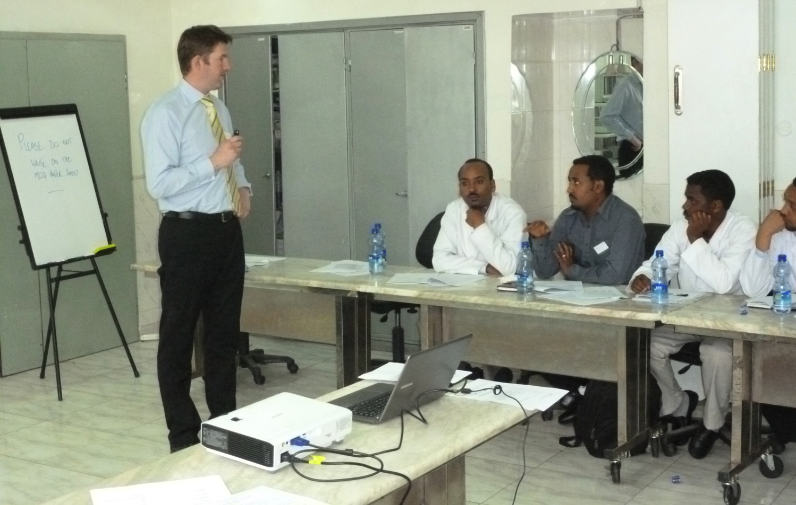
Asking Questions
22

Slide 23
Asking Questions
Aim
To understand different ways of asking questions
23

Slide 24
Questions
Why should we use questions?
24

Slide 25
Question levels
Facts
“What letters are important in Primary Survey?”
Understanding
“Why are these important?”
Application
“How can you apply this to anything else?”
25

Slide 26
Types of Questions
Closed questions
One word answer
Ends discussion
Open questions
Allows ideas to grow
Encourages discussion
26

Slide 27
Learners’ answers
Encourage people to answer questions
Be positive
Make sure group hears the answer
Repeat answer back
If wrong
Still be encouraging
27

Slide 28
?
28

Slide 29
Asking Questions
Summary
Open and closed questions
Question levels
Answers
29

Slide 30
Feedback
Aim
To understand how to give feedback
30

Slide 31
What is feedback?
Two-way and supportive
Looking at
“How you did”
“What you can change”
Positive approach
Five positive points for every negative
31

Slide 32
Feedback in Learning Cycle
Do /
Experience
Feedback
Change
Look
Think
Reflection
32

Slide 33
How to give feedback
Introduction “How do you feel that went?”
“What was good, and why?”
First by learner
Then by teacher
“What can you improve, and how?”
First by learner
Then by teacher
Summary by teacher
33

Slide 34
Giving feedback
On things you can change
Be specific
“when you said…your voice was…”
“when you talked about…your back was to the audience”
34

Slide 35
Make observations on…
Clear aim & summary
Communication with learners
Voice
Eye contact
Body position & movement
Pace & timing
35

Slide 36
Receiving feedback
Listen
Do not over react
Think “do I want to change it?”
Change your behaviour
36

Slide 37
?
37

Slide 38
Feedback
Summary
What was good?
What can be improved?
Be specific
Positive atmosphere
38

Slide 39
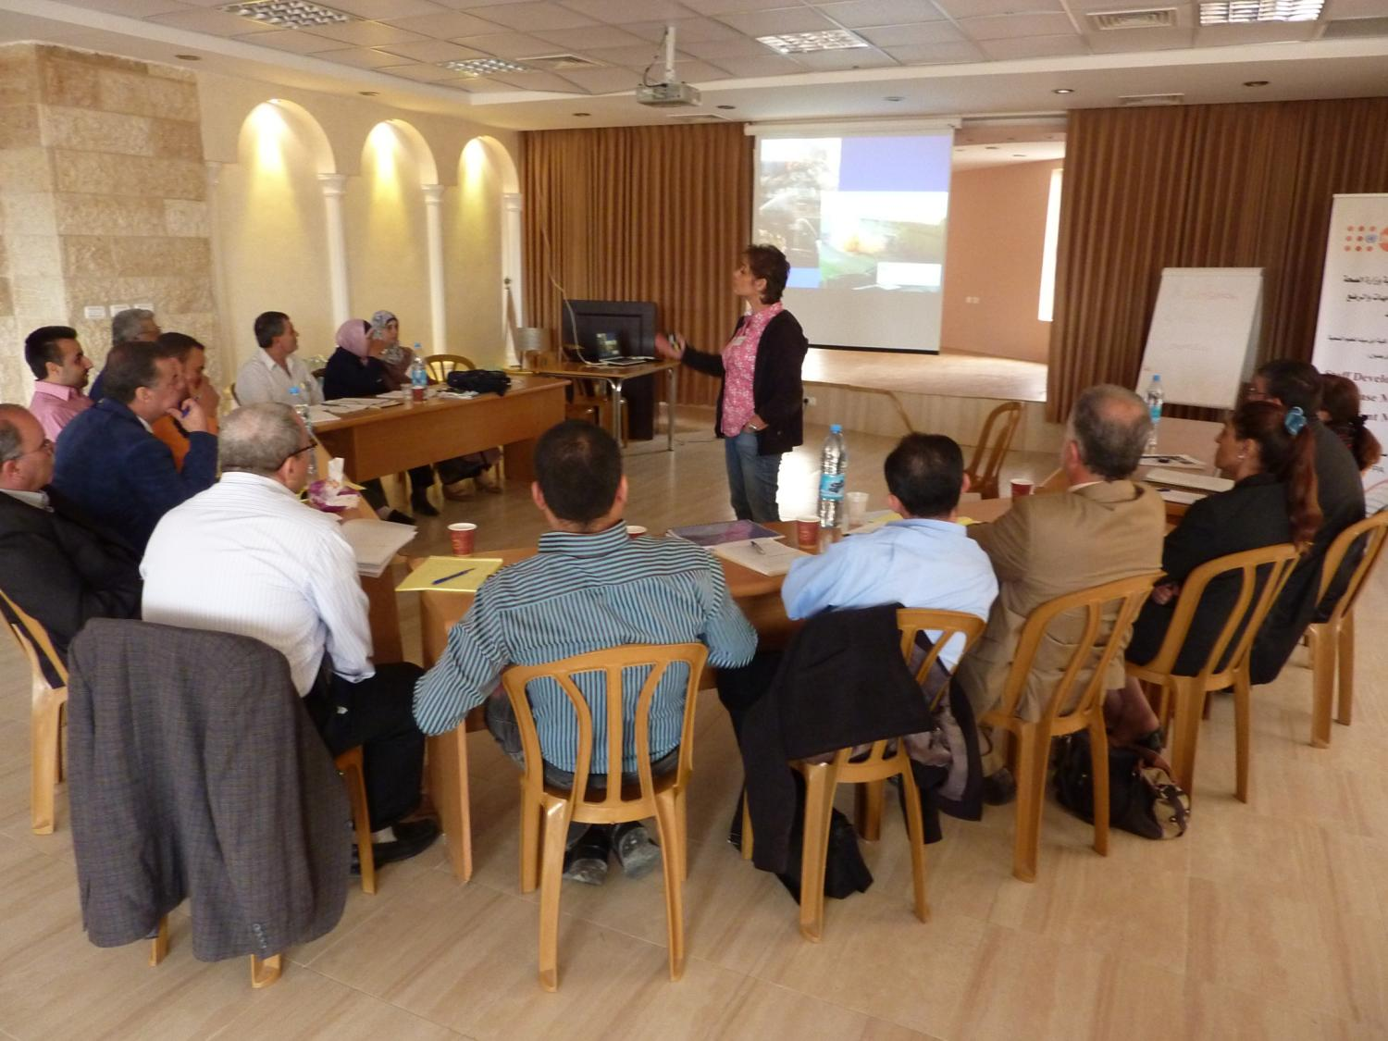
Teaching Methods
39

Slide 40
Teaching Methods
Objectives
To know how to plan your teaching
To use different teaching methods
To understand difficult teaching situations
40

Slide 41
Teaching Methods
Planning
Who, what & how you will teach
Environment
Delivery
Beginning
Middle
End
41

Slide 42
Planning your teaching
Who are you teaching?
Group size
Knowledge level
What are you teaching?
Learning outcomes
How are you teaching?
Lecture, discussion, skill, scenario?
42

Slide 43
Environment
Choose equipment
Powerpoint, black or white board
Use only what is locally available
Choose layout of room
Move the chairs if necessary
Check lighting, AC, noise, mobile phones
43

Slide 44
Delivery
Beginning
State aim and content
Middle
Teach PTC material interactively
End
Questions
Summarise
44

Slide 45
Or…
Say what you are going to say
Say it
Say what you have said
45

Slide 46
Difficult teaching situations
What to do if…?
Someone is too dominant?
Someone is very negative?
Someone does not talk?
Someone starts a side discussion?
Someone falls asleep?
46

Slide 47
What did you notice about the PTC course?
Structure
Motivational MCQ
Planning, Delivery, Feedback
Beginning, middle and end structure
Knowledge, skills and attitudes
How we taught it
Be a role model and be adaptable
Positive feedback
47

Slide 48
?
48

Slide 49
Teaching Methods
Summary
Planning
Delivery
Beginning
Middle
End
49

Slide 50
PTC Teaching Methods
Lecture
Discussion group
Teaching a skill
Scenario
50

Slide 51
Giving a Lecture
51

Slide 52
Lecture
At the end of this session you will
be confident in delivering a PTC lecture
52

Slide 53
Lecture
When?
Large audience (20 or more)
Large amount of information
Introduces facts and ideas
Limited transfer of information
53

Slide 54
Lecture - Planning
Instructor
Who is it for?
Read PTC manual content and slides
Plan beginning / middle / end
Plan timing
Plan interaction and keeping attention
Plan a good finish
54

Slide 55
Lecture - Planning
Environment
Arrange seats in a U if possible
Check lighting
Make sure equipment is working
Check temperature
Minimise external distractions
Have a clock/timekeeper
55

Slide 56
Audiovisual aids
PowerPoint
Use large text
Blackboard / Whiteboard / Flipchart
Write clearly
Allocate someone to write?
Don’t need to use all slides
Plan for power cut
56

Slide 57
Using Slides Effectively
You do not need to use all the slides
Do not change the slide text.
You may add pictures
Read from the laptop not the slides
Use slides to maintain attention
<B> key
Be prepared for a power cut
57

Slide 58
Lecture – Delivery
Beginning
Clear aim and contents
Patient scenario
Middle
Interaction with audience
Mini summaries during lecture
End
Questions
Summarise
58

Slide 59
Interaction with audience
One way
communication
59

Slide 60
Interaction with audience
Two way
Communication:use questions
Answering a question
60

Slide 61
Interaction with audience
Use questions
Use examples relevant to audience
Where will you stand?
Check if audience can see screen or board
Face audience not screen or board
61

Slide 62
?
62

Slide 63
Lecture - Summary
Planning
Delivery
Interaction with audience
Audiovisual aids
63

Slide 64
Practical Session - Lecture
Use short topic from PTC or other topic
Structure not content important
Flipchart / whiteboard / slides
Use Plan, Delivery, Feedback
How you teach more important than what you teach
Five minutes then five minutes feedback
64

Slide 65
Leading a Discussion Group
65

Slide 66
Discussion Group
At the end of this session you will
be confident in planning and running a discussion group
66

Slide 67
Discussion Group
When?
Opportunity for group to work together
Strengthens interaction within group
Good for small groups
Motivating
‘Ownership’ of topic in group
67

Slide 68
PTC Discussion Groups
Neurological Assessment
Pain Management and Analgesia
Transportation
Paediatrics
68

Slide 69
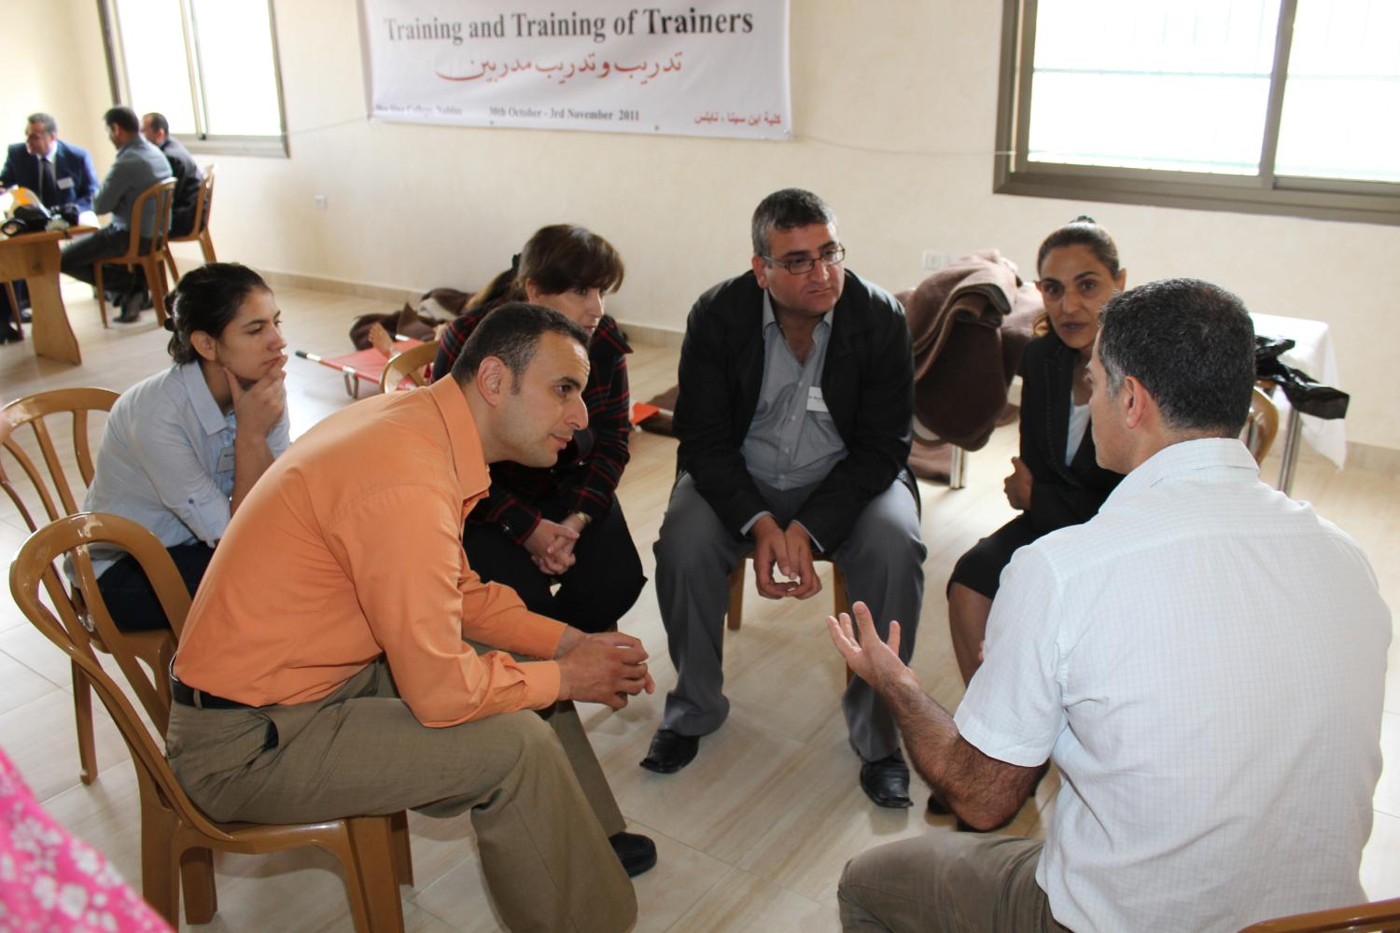
Discussion Group
Demonstration by Faculty Trainers
69

Slide 70
Discussion Group
What was the teaching aim?
How did the instructor lead the group to achieve this?
Could you hear?
Could you see?
Why did it go well?
70

Slide 71
Discussion Group - Planning
Use appropriate topic
Learners’ knowledge levels
Learn group members’ names
71

Slide 72
Discussion Group - Environment
Choose equipment
Flipchart / white or blackboard
Choose seating layout
72

Slide 73
Discussion group – Delivery
Beginning
Clear aim
Allocate someone to write if necessary
Middle
Interaction with audience
End
Questions
Summary
73

Slide 74
Interaction in group
74

Slide 75
How to get interaction in group
Introduce topic
Use open questions
Encourage participation from all
Use Brainstorming for more ideas
Stay on topic
75

Slide 76
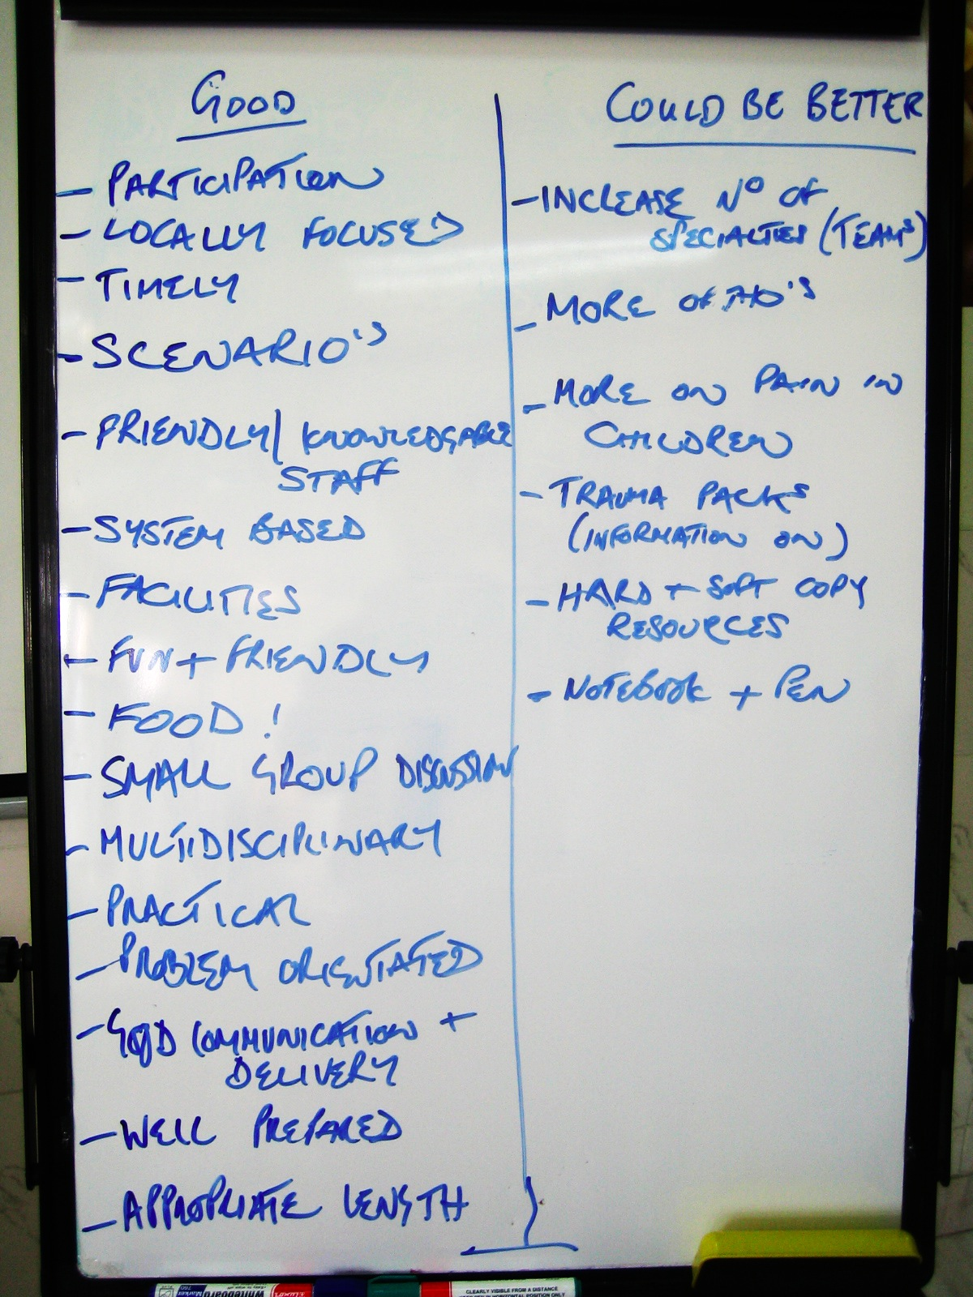
Brainstorming
Larger group
Decide topic
Take turns for ideas
“Pass”/ “No comment” allowed
Write down accurately
Continue until ideas cease
Decision
76

Slide 77
?
77

Slide 78
Discussion group - Summary
Planning
When and how
Delivery
Interaction in group
Brainstorming
Difficult teaching situations
78

Slide 79
Practical Session – Discussion Group
Use short topic from PTC
Structure, not content, important
Use Plan, Delivery, Feedback
Open and closed questions
How you teach more important than what you teach
Five minutes then five minutes feedback
79

Slide 80
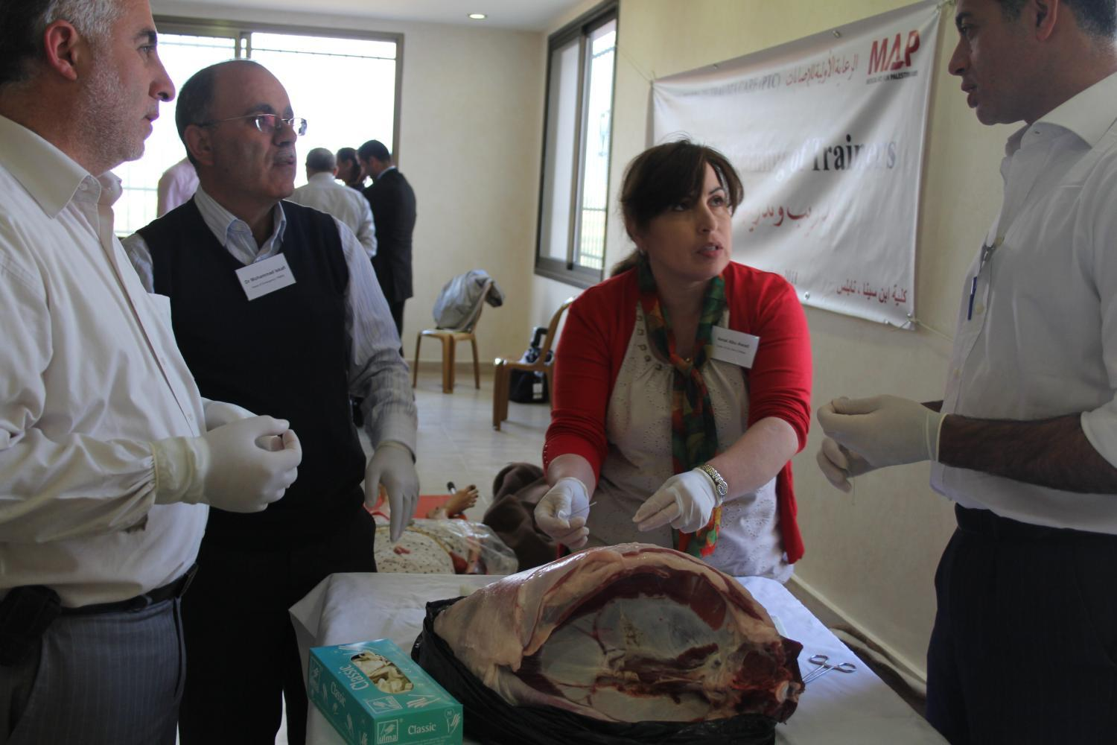
Teaching a Skill
80

Slide 81
Teaching a Skill
At the end of this session you will
be confident in teaching a PTC skill
be confident to run a skill station
81

Slide 82
Teaching a Skill
When?
Small groups 5 to 10
Combination of skill learning and discussion
82

Slide 83
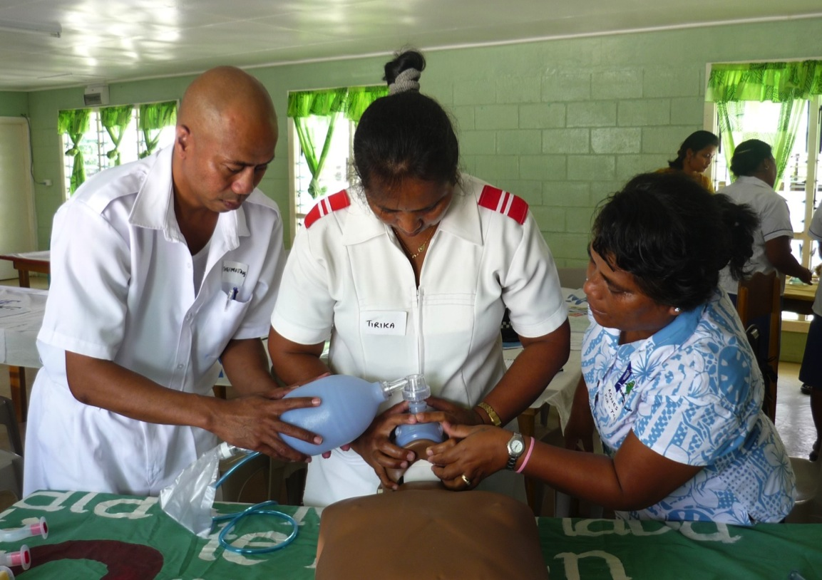
Teaching a Skill
Demonstration by Faculty Trainers
83

Slide 84
Teaching a skill
Why do we teach in this way?
To move -
from beginner
to competent practitioner
to experienced clinician able to teach
84

Slide 85
Teaching a skill – 3 stages
Instructor does at normal speed
Instructor does slowly and explains
Learner does and explains to another learner. Instructor acts as coach
85
Notes:
First demo normal speed to….
Then slow and explained

Slide 86
Skills – Planning
Teacher
Learners’ knowledge and skills
Learning outcomes
86

Slide 87
Skills – Planning
Environment
Space, distractions, lighting --
Choose equipment
Use what is locally available
No expensive equipment
87

Slide 88
Skills - Delivery
Beginning
Clear aim and context
Middle
Describe use of equipment or skill
3 stages
Interact with whole group
End
Questions and Summarise
88

Slide 89
?
89

Slide 90
Teaching a skill - Summary
Planning
Delivery
3 stages
90

Slide 91
Practical Session - Skill
Use short skill from PTC or another skill
Structure not content important
Use Plan, Delivery, Feedback
3 stage technique
How you teach more important than what you teach
Five minutes then five minutes feedback
91

Slide 92
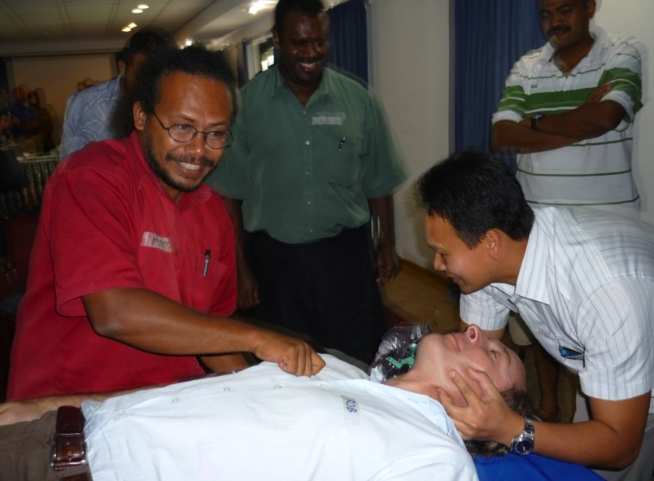
Teaching using Scenarios
92

Slide 93
Scenarios
At the end of this session you will
be confident in planning and directing a scenario
93

Slide 94
Scenarios
When?
5-10 people
Realistic
Motivating, safe and enjoyable
Brings together all aspects of the course
Can be used as assessment tool
94

Slide 95
Scenarios
Why do we have scenarios?
95

Slide 96
Scenarios
Demonstration scenario
Reinforces key PTC message
Demonstrates
what a clinical scenario is
how it runs
Practice scenarios
96

Slide 97
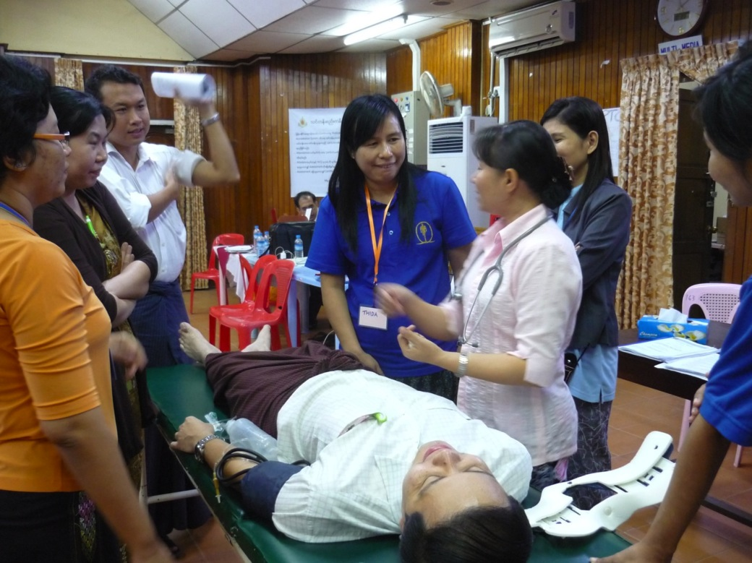
Scenario
Demonstration by Faculty Trainers
97

Slide 98
Scenarios
Demonstration Scenario:
What was the teaching aim?
How did the Instructor achieve this?
Could you hear?
Could you see?
Why did it go well?
98

Slide 99
Scenarios
What do you learn from the demonstration Scenario?
“Hands-on”, realistic, interactive, safe
Preparation is essential
Roles are clear
99

Slide 100
Scenario Planning - Content
Learners’ experience & knowledge
Read scenarios
Plan briefing and timing
Consider practice run-through
100

Slide 101
Scenario planning - Environment
Privacy, noise, distraction, lighting
Enough space
Use local equipment
Use people as models
Use bed or trolley
101

Slide 102
Scenarios - Delivery
Allocate roles
‘Doctor’, patient, nurse, observer(s)
‘Doctor’ out of room
Full story told to group
‘Doctor’ back in room - give history
Encourage realistic role play
“Hands and stethoscopes on”
102

Slide 103
Difficult Scenario Situations
Participant gets stuck
Participant misses an important cue
Participant makes critical mistake
Participant goes too fast
Participant does a technique wrong
103

Slide 104
?
104

Slide 105
Scenarios - Summary
Planning
Delivery
Feedback
105

Slide 106
Practical Session - Scenario
Choose part of one of the PTC scenarios
Use Plan, Delivery, Feedback
How you teach is more important than what you teach
3 minutes prepare, 5 minutes scenario then 3 minutes feedback
106

Slide 107
Language issues
Aim
To be aware of difficulties for second language listeners
To understand how to work with a translator
107

Slide 108
Second language
Keep it simple
Slow down
Stick to words on slides
Write down important concepts
Avoid jokes
108

Slide 109
Translation
Talk will take twice as long
Simple short sentences
Slow down - halve your input
Prepare your script & stick to it
Give key points to translator
109

Slide 110
Discussion groups
Repeat questions word for word
Simplify questions if necessary
If silence – are the questions too complicated?
110

Slide 111
Board or flipchart
Let a local person write
111

Slide 112
?
112

Slide 113
Language issues
Summary
Keep it simple
Keep it slow
Keep it short
Write it down
113

Slide 114
Planning for the PTC Course you will be teaching
At the end of this session you will be able to
plan for PTC courses
allocate roles for the next PTC course
work together as a team
114

Slide 115
How to run a PTC Course
What is required to run a PTC course?
115

Slide 116
Tomorrow’s PTC Course
Checklist
People
Programme
Location and venue
Publicity
Food and drink
Paperwork
Follow-up
116

Slide 117
Planning the PTC Course
Your own preparation and planning
Environment
117

Slide 118
Planning the PTC Course
Course Programme
Extra roles
Course director
Participant Registration
Timekeeper
Equipment / computer person
Daily logistics and session set-up
Paperwork
118

Slide 119
Running the PTC course
How will the day run?
Get there early
Registration
Programme
End of day Instructor meeting
119

Slide 120
Running the PTC course
Prepare the learning environment
Prepare a safe environment
Take charge of safety
Rehearse demonstration scenario
120

Slide 121
?
121

Slide 122
Summary
PTC concept
How adults learn
Asking questions
Feedback
Teaching methods
Planning your course
122

